Slide 1
U.S. Wildfires: Linear Regression Analysis to Predict Relationship between Environmental Factors and Spread of Wildfires Using R Studio
By Shiven, Grade 6

Slide 2
Abstract
There is always a source, a specific climate condition, and a certain temperature to start a wildfire and eventually widespread. The long-term goal is to predict the spread of the fire and take preventive measures before fatal and serious damages to the human life and property happens. In this research project, I considered various environmental factors (independent variables) on the day of the wildfire instance, for example, temperature, wind speed, dew point, and precipitation, to determine a linear model for predicting wildfire spread (dependent variable). By employing statistical analysis on the linear regression model (RStudio), the significance of each factor’s effect on the spread of the wildfire was determined. The data for average temperature, high temperature, and dew point is normally distributed and these individual variables seem to show a relationship with the wildfire area, but only high temperature showed a significant relationship (p value of 0.031). The linear regression analysis of combined independent variables refuted my hypothesis that a warm, dry, and windy conditions will have a significant impact on the creation and spread of a wildfire. It appears that a simple linear model will not be an effective form of prediction for spread of wildfires.

Slide 3
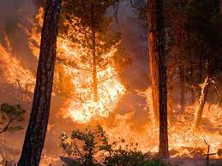
Why should we care?
Damaging Effects of Wildfires:
Fatalities
Health issues (Respiratory, Cardiovascular, Allergy, COPD etc.)
Damage to public and private property
Water and air quality
Economic impact due to property loss and costs of containing and managing wildfires
Carbon emission
Ecosystem alteration
(Source: https://www.nasa.gov/topics/earth/features/climate-fire.html)
Notes:
https://www.rff.org/publications/explainers/wildfires-in-the-united-states-101-context-and-consequences/

Slide 4
Background
Wildfires are a threat to human life, property and economy, yet they are a part of
nature and in some instances they are necessary for the maintenance of ecosystems and evolution of forests. Multiple Studies have found that climate variations impact the extent, frequency and area coverage of wildfires (1-3). The warmer and drier conditions have always contributed towards wildfires in the western United States (3, 4). In order to minimize the damages, scientists and researchers have tried to predict and understand the behavior (speed, direction, modes of spread) of wildfires. However, there are a lot of factors involved, such as complex fuel configurations, complicated chemical kinetics, and balances between different modes of heat transfer, that can lead to different behaviors and difficult to accurately predict. Current models for numerical description of wildfire propagation are mainly algebraic and based on statistical or physical attributes, while others are based on ideas that incorporate rough approximations to the complex physical and chemical processes.

Slide 5
Hypothesis
Hypothesis: A warm, dry, and windy climate will have a significant impact on the creation and spread of a wildfire, and that a linear model will be an effective form of prediction for spread of wildfires

Slide 6
Methods
Datasets and Variables
Data for wildfire instances in the U.S. from 2000 to 2009 in the form of latitude and longitude obtained from Latlong, www.latlong.net). This is the only data I could find in the public domain.
For each event, information was collected for the city/county (location) from historical weather analyzer (https://www.wunderground.com/history)
Data for the average temperature, highest temperature, dew point, precipitation, and wind speed in Microsoft Excel for Modeling and Prediction work
506 U.S. locations of wildfire events and over 2500 data points including 5 different independent variables and one dependent variable
Notes:
For my project, The data in the form of latitude and longitude was obtained from (Latlong, www.latlong.net) which consists of wildfire instances in the U.S. from 2000 to 2009. This is the only data I could find in the public domain. For each wildfire instance, information on the city/county (location) will be obtained. After that I will analyze each location and use a historical weather analyzer (https://www.wunderground.com/history) to retrieve the average temperature, highest temperature, dew point, precipitation, and wind speed on that day. All the data will be collected in excel format for further analyses and prediction work. All together I have 506 locations of wildfire events and over 2500 data points that include 5 different independent variables.

Slide 7
Application
RStudio: An open-source application for programming, data analyses, and graphics
Independent Variables
Average Temperature
Highest Temperature
Dew Point
Wind Speed
Precipitation
Dependent Variable
Area Hectare
Prediction model
Linear Regression

Slide 8
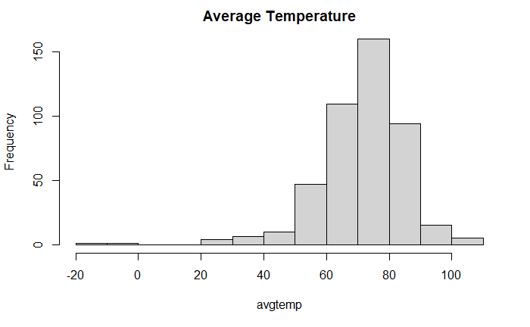
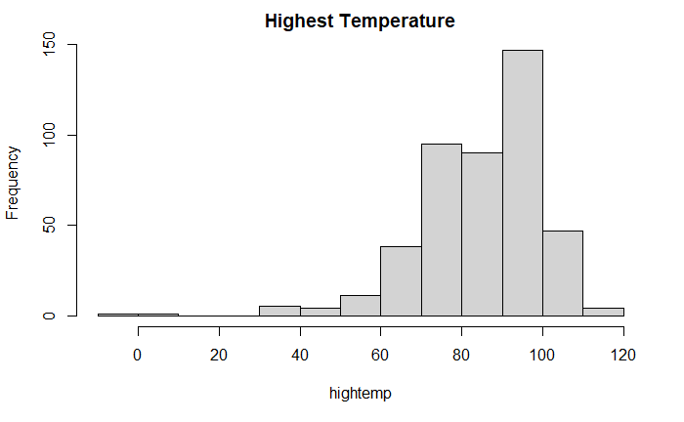
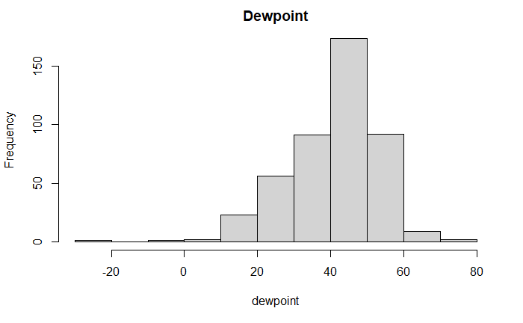
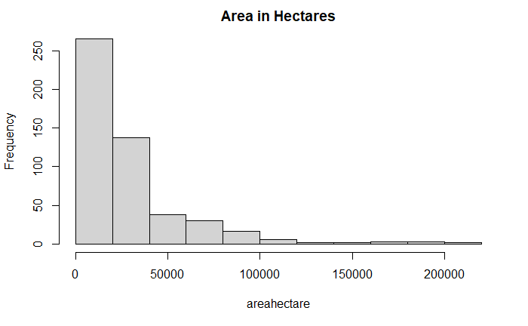
Results
A
B
C
D
Notes:
Figure 1: Histogram for normality test of variables. Used the hist() function to test whether variable follows a normal distribution.
-Depicting frequency of independent/dependent variables.
1 (A) Average Temperature: The Average Temperature distribution seems not be skewed and in the bell shape, although there are some outliers from -20 to 0.
1 (b) Highest Temperature: The Highest Temperature distribution seems to not be skewed either and is also in a bell shape. There are some outliers ranging from -10 to 10.
1 (C) Dew point: The Dew point distribution is a bit skewed to the left and there are some outliers closer to the negative category.

Slide 9
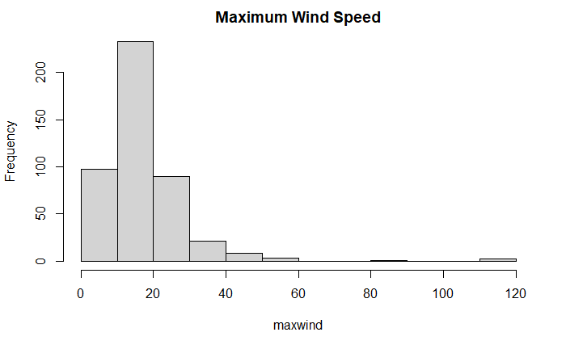
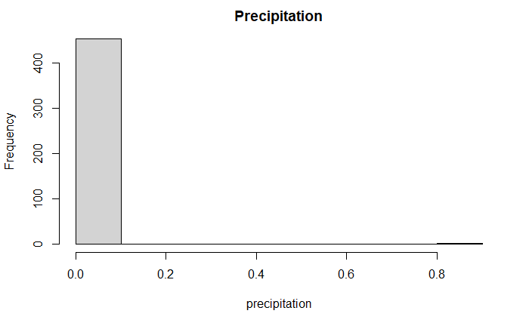
E
F
Figure 1: Histograms of normality test of variables. (A) average temperature, (B) high temperature, and (C) dewpoint distribution in general are normally distributed with few outliers. (D) area hectares and (E) maximum wind speed distribution is skewed to the right with (F) precipitation distribution generally collective at 0.0
Notes:
Figure 1: Histogram for normality test of variables
-Depicting frequency of independent/dependent variables
1 (D) Area in Hectares: The Area in Hectares distribution is very skewed to the right as is max reaches 200 thousand.
1 (E) Max Wind Speed: The Max Wind Speed distribution is a bit skewed to the right and there are a couple of outliers towards left closer to 80 and 120 (Max Wind Speed is in Mph).
1 (F) The Precipitation distribution is very collective in the 0.0 category, although there is/are some outliers in the 0.8 category.

Slide 10
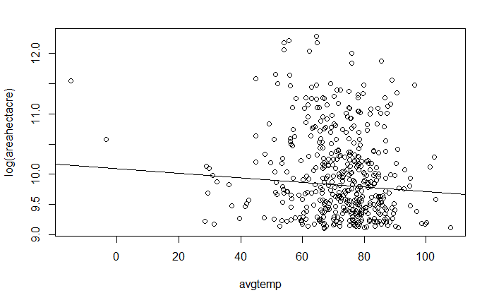
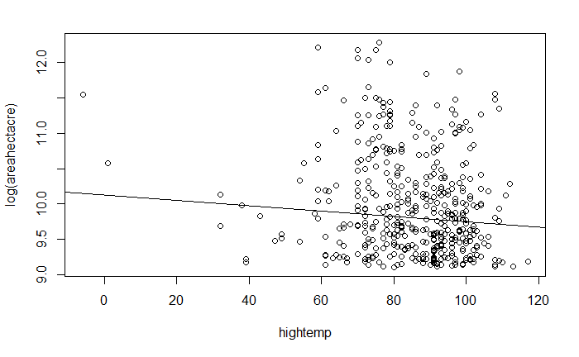
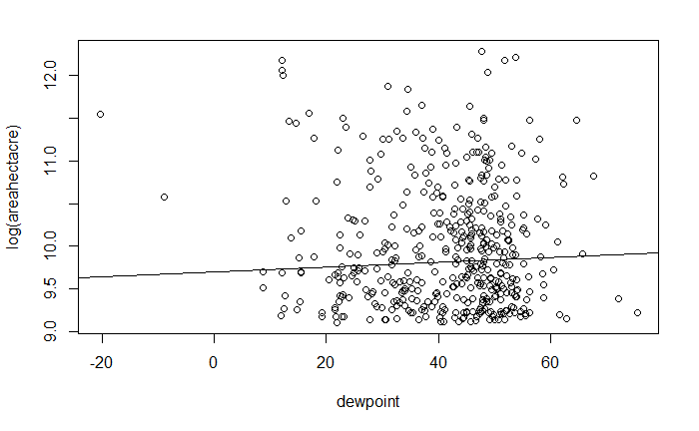
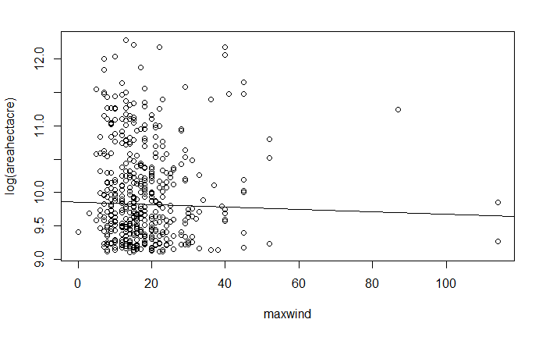
A
B
C
D
Notes:
Figure 2 Scatter Plots: frequency of independent/dependent variables with log-transformed data. Regression Line is set at 0
Although the relationship between temp and fire spread is a bit less clear, it still appears somewhat linear.
From the summary statistics of the model, we can see that there is a t-value of -1.933, which is compared to the t distribution, giving us a p-value of 0.054. Hence we can conclude that there is not strong enough evidence to suggest that there is a difference in the relationship between average temperature and log area in Hectares.
From the summary statistics of the model, we can see that there is a t-value of -2.16, which is compared to the t distribution, giving us a p-value of 0.0314. Hence we can conclude that there is strong enough evidence to suggest that there is a difference in the relationship between highest temperature and log area in Hectares.
From the summary statistics of the model, we can see that there is a t-value of 1.294, whichis compared to the t distribution, giving us a p-value of 0.196. Hence we can conclude that there is not strong enough evidence to suggest that there is a difference in the relationship between dew point and log area in Hectares.

Slide 11
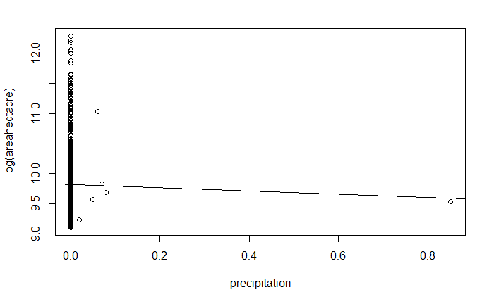
E
Figure 2: Scatter plots of linear regression analysis showing frequency of independent variables and relationship with dependent variable (area hectare).
Notes:
Figure 2 Continued: frequency of independent/dependent variables with log-transformed data. Line is log 10=0
From the summary statistics of the model, we can see that there is a t-value of -0.737, whichis compared to the t distribution, giving us a p-value of 0.461. Hence we can conclude that there is not strong enough evidence to suggest that there is a difference in the relationship between max wind speed and log area in Hectares.
From the summary statistics of the model, we can see that there is a t-value of -0.447, whichis compared to the t distribution, giving us a p-value of0.655. Hence we can conclude that there is not strong enough evidence to suggest thatthere is a difference in the relationship between precipitation and log area in Hectares.

Slide 12
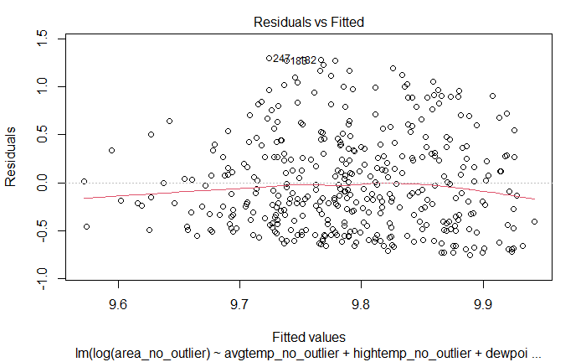
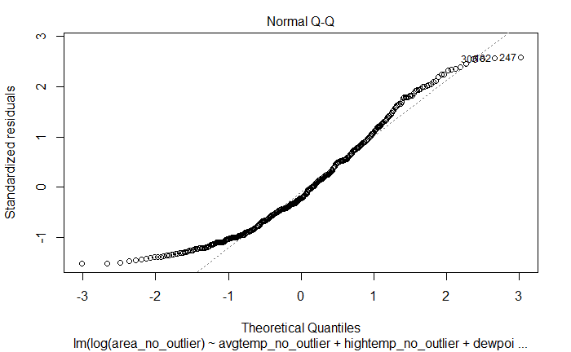
A
B
Figure 3: Model Diagnostics. (A) shows that the residuals have constant variance when plotted against fitted values. (B) shows that normality assumptions of my model is not met though some of the data points are completely aligned with the regression line and there are multiple outliers.
Notes:
Figure 3: Model diagnostics
These two plots are important diagnostic tools in assessing whether the linear model is appropriate.
Residuals vs. Fitted When a linear model is appropriate, we expect the residuals will have constant variance when plotted against fitted values; and the residuals and fitted values will be uncorrelated.
In Figure 3 A. Residual Vs Fitted Plot is showing a residual analysis. It is a scatter plot of residuals on the y axis and fitted values (estimated responses) on the x axis. The plot is used to detect non-linearity, unequal error variances, and outliers. I noticed that linearity is violated. Whether there is homoskedastic or not is less obvious: I will need to investigate more analyses models in future. There are several outliers.
4 (B): Normal QQ plot You can use a linear model for prediction even if the underlying normality assumptions don’t hold. However, in order for the p-values to be believable, the residuals from the regression must look approximately normally distributed.
4(a):
4 (b): Q-Q plot,

Slide 13
Conclusions
Individual variables (avg temp, high temp, dew point) seem to show a relationship with the logarithm of the area but only high temperature showed a significant relationship with p value less than 0.05
Multivariate model resulted with constant variance but violated linearity conditions
Hypotheses refuted and there are a few possible causes
Outliers
Linear Model may be too simple for complex set of data

Slide 14
Future Research
Refine the prediction analysis. Clean up the current data by removing the outliers and re-run the linear model.
Collect additional data for more recent U.S. wildfires and increase the sample size.
Analyze the data using complex regression analysis assuming that climatic conditions could be cross talking to each other and impacting spread of wildfire.
Improve analyses programming skills. I started learning R very recently and from this project I can see room for improvement.
Explore potential collaborations and get access to data from reliable sources such as EPA and NASA.

Slide 15
References
https://www.epa.gov/climate-indicators/climate-change-indicators-wildfires
Stevens LE; et al. Climate change in the human environment: Indicators and impacts from the Fourth National Climate Assessment. J Air Waste Manag Assoc. 2021 Oct;71(10):1210-1233..
Kitzberger T; et al. Contingent Pacific-Atlantic Ocean influence on multicentury wildfire synchrony over western North America. Proc Natl Acad Sci U S A. 2007 Jan 9;104(2):543-8.
Westerling AL. Increasing western US forest wildfire activity: sensitivity to changes in the timing of spring. Philos Trans R Soc Lond B Biol Sci. 2016 Jun 5;371(1696):20150178.

Slide 16
Acknowledgement
My science teacher for help and support.
Thank you for listening and showing your interest in my research project

